Slide 1
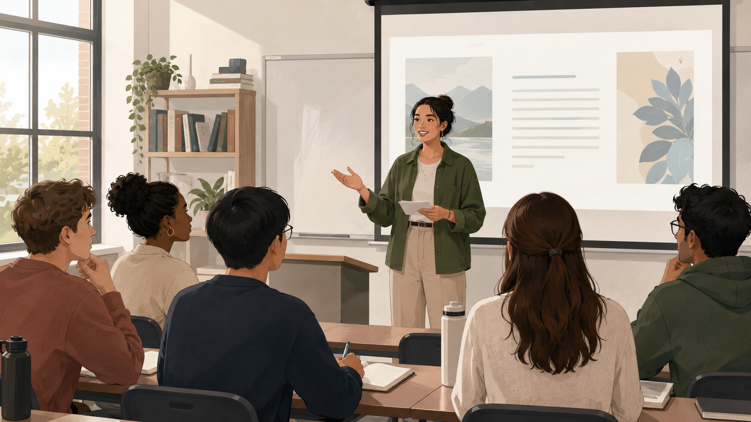
LAN 100
Oral Presentation
My Future Goals
Academic & Personal Ambitions
10% assessment • individual • 4–5 minutes • PowerPoint required
LAN 100 Oral Presentation • 1
Notes:
Introduce the assessment as a genuine oral presentation. Emphasise that the PowerPoint supports the speaker; it does not replace the speaker.

Slide 2
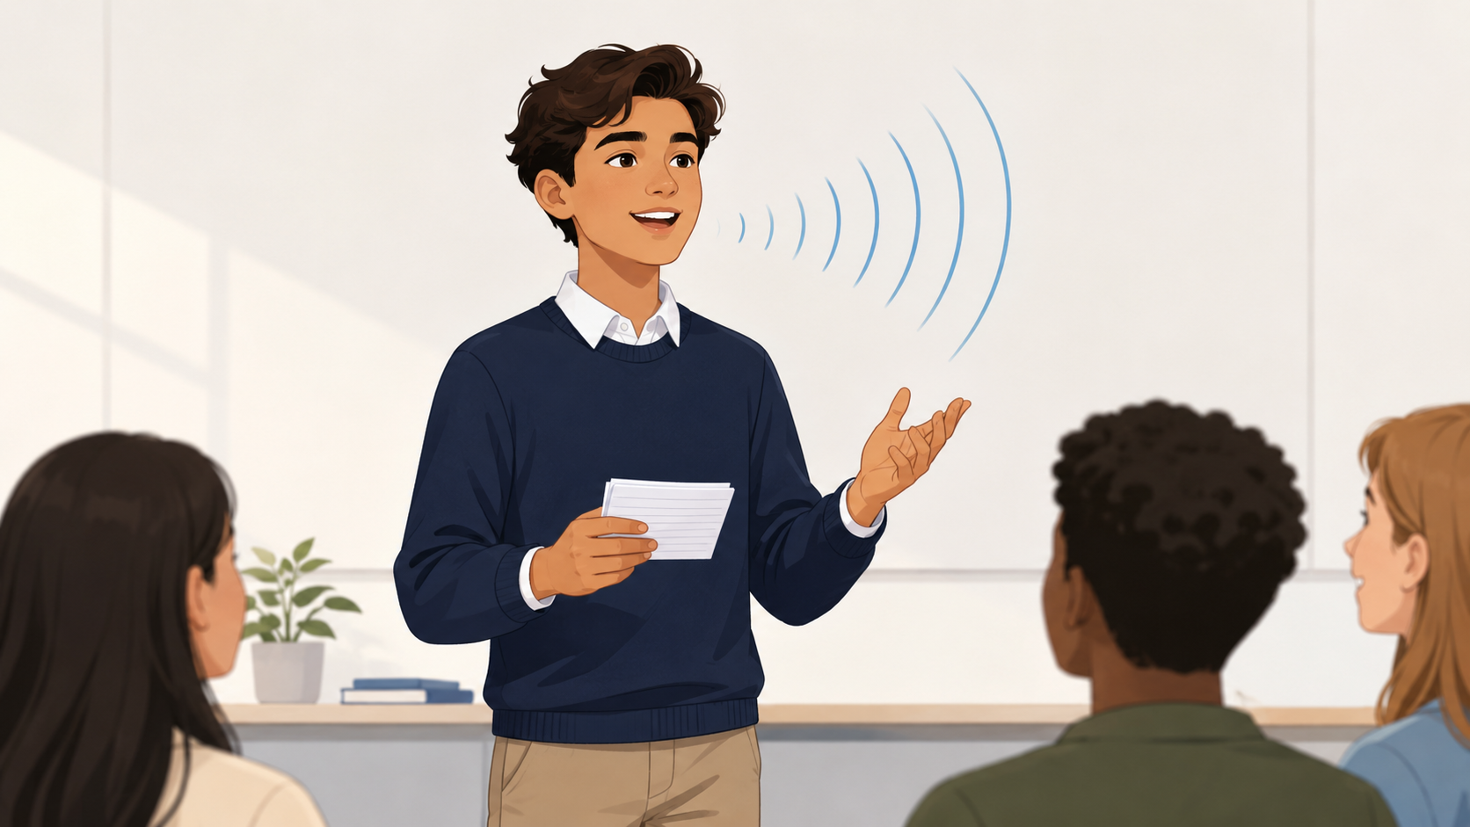
THE TASK
Students present four future goals and explain each one clearly in their own words.
Each goal must include one relevant, researched piece of information from a documented source.
Presentation = personal ambition + useful information + clear spoken explanation
LAN 100 Oral Presentation • 2
Notes:
This slide gives students the whole task in one clear sentence.

Slide 3

Four required goals
Specific, meaningful and future-focused
Academic
Career
Hobby / Interest
Free Choice
study, degree, qualification, learning aim
future profession, workplace, internship
skill, activity, passion, project
travel, service, personal growth, community
LAN 100 Oral Presentation • 3
Notes:
Use examples only to clarify the categories. Students can choose ambitions that are realistic, imaginative, short-term or long-term.

Slide 4
For each goal, include three things
This makes the presentation personal but still academic
1
Ambition
+
2
Explanation
+
3
Research
State the goal clearly.
Explain why it matters and how you might achieve it.
Add one useful fact from a reliable documented source.
Example: “I want to study for a PhD” → Which university? What does the programme focus on? What requirement or research area is relevant?
LAN 100 Oral Presentation • 4
Notes:
This slide is useful because it prevents students from making a very general personal talk. They must add a small piece of documented information.

Slide 5

Research + APA referencing
One source-supported fact for each goal
Use reliable sources: university, professional, government or recognised organisation websites.
Include a short APA-style citation on the relevant slide.
End with a References slide in APA 7th edition format.
Do not cite ChatGPT as the factual source.
APA help: apastyle.apa.org/style-grammar-guidelines/references/examples
LAN 100 Oral Presentation • 5
Notes:
Stress that APA is part of academic practice, but keep expectations appropriate to B2. A consistent attempt at APA 7 is enough for this 10% task.

Slide 6
MODEL
What one goal slide might look like
Academic Goal
Researched information
I would like to complete a master’s degree in environmental engineering.
A university programme I found includes courses connected to sustainable infrastructure and water management.
Why this goal matters to me
• I am interested in climate solutions.
• I want to work on practical water or energy projects.
(University name, 2026)
Slide = keywords only. The spoken explanation gives the detail.
LAN 100 Oral Presentation • 6
Notes:
This is deliberately simple. It demonstrates citation placement without inviting students to paste a whole script.

Slide 7
PowerPoint supports the speaker
Slides should be attractive, clear and simple
Use short headings, keywords and brief bullet points.
Use relevant visuals: photos, maps, logos or diagrams.
Check spelling carefully.
Do not put the full speech on the slides.
Include a final References slide.
The old rule still applies: make slides attractive — but keep them SIMPLE.
LAN 100 Oral Presentation • 7
Notes:
This slide adapts the useful reminders from the previous article presentation deck: PowerPoint required, attractive visuals, no spelling mistakes, simple slides.

Slide 8
Explain. Do not read.
The assessment is spoken communication, not slide-reading
Students should:
speak in their own words
paraphrase researched information
refer to sources naturally
use prompt cards only if needed
show they understand every slide
Useful phrase: “The source explains that…” / “According to this university page…”
LAN 100 Oral Presentation • 8
Notes:
This draws directly on the strongest principle from the old article-summary presentation: students must explain in their own words and avoid reading.

Slide 9
DELIVERY REMINDERS
Look animated. Be expressive. Speak to the audience.
Voice
speak loudly and clearly
Eye contact
look at the audience
Stage presence
stand confidently and use space
Body language
minimise nervous gestures
English only
keep the presentation in English
LAN 100 Oral Presentation • 9
Notes:
This slide incorporates relevant body language, voice and audience reminders from the older oral presentation PowerPoint.

Slide 10
AI may help preparation
But it cannot replace student understanding
Appropriate support
Not acceptable
brainstorming ideas
checking vocabulary or grammar
organising slide order
improving visual clarity
using AI as the factual source
reading an AI-written script
including information the student cannot explain
copying without checking
The grade comes from what the student can explain live in class.
LAN 100 Oral Presentation • 10
Notes:
Frame this positively: digital help is allowed for preparation, but spoken communication and understanding are assessed in class.

Slide 11
Grading rubric: 10 marks
Five criteria, two marks each
1. Content & Development
four clear goals + meaningful explanation
2
2. Organisation & PowerPoint
logical structure + clear supporting slides
2
3. Spoken Language
B2 vocabulary, grammar and pronunciation
2
4. Delivery & Communication
clear speech, audience contact, limited reading
2
5. Research, Explanation & APA
relevant facts, source citation, own words
2
Total: 10 marks
LAN 100 Oral Presentation • 11
Notes:
This is deliberately simple so it can be used quickly while students are presenting.

Slide 12
Before presentation day
I have four required goals.
Each goal has one researched fact.
Each source is cited in APA style.
My slides are simple and visual.
I can explain everything without reading.
Final message to students: Your slides show the key information. You explain the story behind them.
LAN 100 Oral Presentation • 12
Notes:
Use this as the closing reminder. Invite questions about topics, sources or presentation length.

